Slide 1
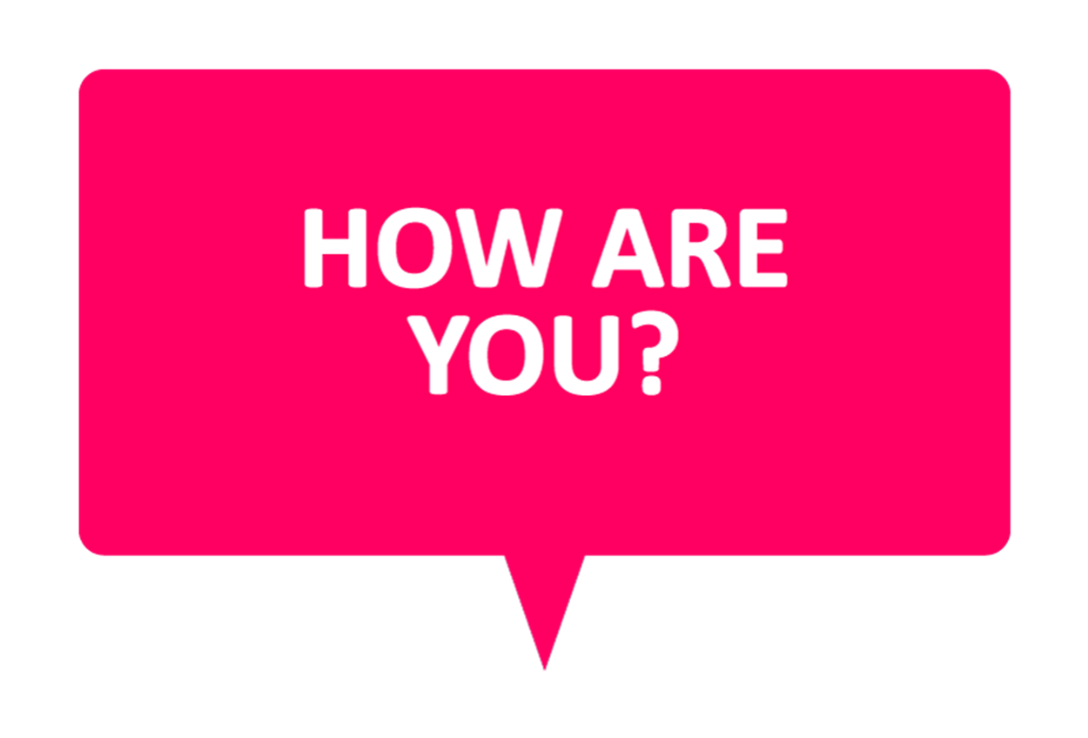
WELCOME TO ENGLISH CLASS

Slide 2


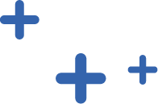
WELCOME TO ENGLISH CLASS
“If you can dream it, you can do it.”
Walt Disney

Slide 3
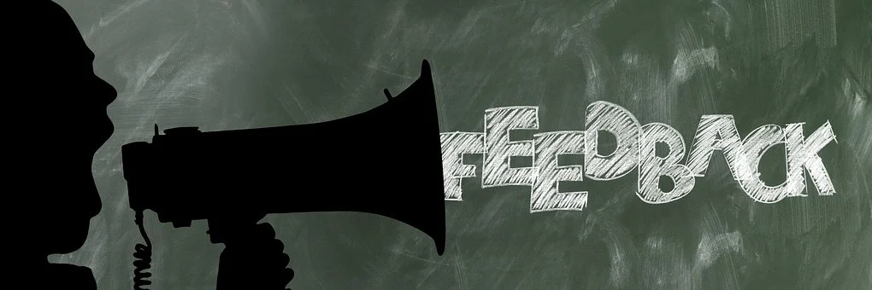
User feedback in software

Slide 4

DATE
DATE
Objective:
Students will be able to discriminate between main ideas and secondary ideas about user feedback.

Slide 5

AGENDA
WARM UP:
Watch a short video about feedback
CLASS ACTIVITY:
New Vocabulary
Reading Strategy: Looking for main ideas
Reading:User Feedback in Software Development
Wrap- Up
Categorize the ideas from the text into “Main and Secondary”

Slide 6

WARM-UP
Watch the following video, and then explain to your teacher what you understand by feedback
https://www.youtube.com/watch?v=5h16NsjVD6Y

Slide 7

VOCABULARY
feedback : retroalimentación
user usuario
complaint : quejarse
improve mejora
features caracteristica
Try tratar
Developers desarroladores
test cases: casos de prueba
useful util
updates actuañlizar
team equipo
Bugs correciones
VOCABULARY

Slide 8
Word search
Follow the directions:
Find the vocabulary words in the following word search.
Use the words you found in short sentences.
There is one example :
Our boss gave us a good feedback
T | D | L | A | S | B | T | S | I | C
F | E | O | R | G | T | R | Y | M | O
D | V | S | V | U | E | T | L | P | M
F | E | E | D | B | A | C | K | R | P
A | L | P | R | N | M | G | H | O | L
U | O | L | U | F | E | S | U | V | A
D | P | U | A | L | O | T | S | E | I
T | E | S | T | C | A | S | E | S | N
D | R | E | L | T | A | E | F | K | T
U | S | R | E | R | U | T | A | E | F
R | W | Y | M | Q | Z | P | L | R | K
T | U | N | R | D | H | V | Z | T | L

Slide 9

Video Reading Strategy
https://youtu.be/LbO3lRXT0ww

Slide 10
User Feedback in Software Development
Practice the Reading strategy “looking for main ideas” by doing the following Steps :
First, you have 1 minute to read only the parts of the text that are highlighted with yellow.
After reading the text that is highlighted with yellow. Please answer “Main Ideas Comprehension” questions.
Finally, read the whole text and answer the questions in the Evaluation section.

Slide 11
Main Ideas Comprehension
Read the following statements and select the correct option.
User feedback helps/doesn´t help you make the product better.
User´s requirements are essential/irrelevant in software development.
Software developers can/cannot predict all the possible bugs in advance.
One user´s feedback is/is not useful in software development.
Positive feedback makes the users/developers feel happy.

Slide 12
User Feedback in Software Development
User Feedback in Software Development
Feedback is a very important component in any work. Feedback helps you clarify your understanding. Feedback helps you see things in new ways. Feedback helps you correct your course. Feedback helps you learn. Feedback makes you and your work better.
Introduction
Software is created to satisfy user’s requirements. A software is good if the majority of the users have no complaint about it after using for a long time. As a consequence, more and more attention today is paid to user feedback. Software companies want to know what their users really think of their products, which aspect they consider important, what functions they expect, etc.

Slide 13
User Feedback in Software Development
They want to learn as much as possible from their users to improve their product quality.
Particular Characteristics of User Feedback in Software Development
User feedback is important to all types of product development, and software is no exception. However, different to others, software development has its own features that make user feedback different.
First of all, in software development it is impossible to predict all the problems in advance. The only way the developer can know if the software works or not is by letting users try them. Although the developers can write some test cases, those test cases are created from the point of view of the developers and not from the point of view of the users. Only when developers receive feedback from the users can they really know what’s wrong.

Slide 14
User Feedback in Software Development
Second, even only one user´s feedback can be useful for software development. Of course, the more users give feedback, the better for the developers, but sometimes even one comment can help improve the product.
Additionally, updates are necessary in software development, especially for mobile applications. If an application stops updating for several months or even several weeks, people will use other applications with similar functions instead. Logically, the updates take into account the information from the user feedback.
Finally, it is widely accepted that positive user feedback will make the development team much more confident. So user feedback is not only about negative comments and reports of bugs, it is also about good things that people like about programs and applications.

Slide 15
User Feedback in Software Development
Conclusion
The quality of the product is always the most important thing during software development. No matter how well we know our users, if we cannot satisfy their requirements, our work means nothing. In software development, it is impossible to predict all the problems before people start using the program/application. Remember that negative feedback is better than no feedback. Any information can be useful, it just depends on how we use it.

Slide 16
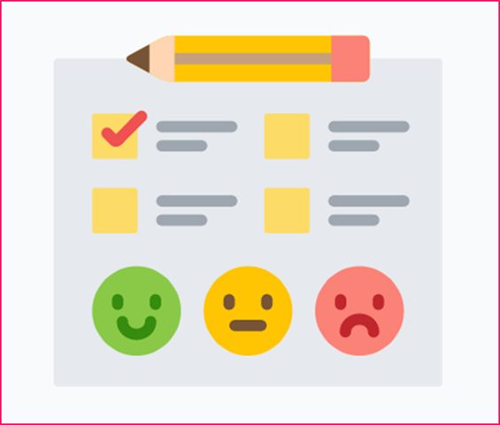
WRAP-UP
Categorize the following ideas from the text into “Main” and “Secondary”.
User feedback is the information about users´ positive/negative experience.
Feedback can include positive and negative comments.
In software development, it is necessary that people use a program for the developers to know what problems can appear.
Companies pay a lot of attention to user feedback these days.
Mobile applications should have frequent updates.
Software developers can write test cases.
Companies want to know what functions users expect from their product/service.

Slide 17
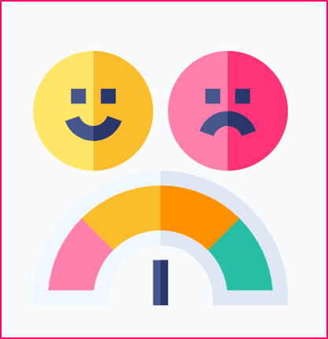
SELF-EVALUATION
Answer the following questions.
Entiendo qué es “user feedback” y por qué es importante. Si No Tal vez
Entiendo cómo utilizar la estrategia de “Looking for main ideas”. Si No Tal vez
La estrategia “Looking for main ideas” me ayuda a entender la idea general de un texto. Si No Tal vez
Entiendo la diferencia entre las ideas principales y las ideas segundarias. Si No Tal vez

